Slide 1

Kubernetes Fast-Dive
Ryan nowak & David Fowler

Slide 2
About US
We work on .NET.
Everything web, cloud, and microservices

Slide 3
If I’m building web applications in 2020 where do I deploy stuff?

Slide 4
You could deploy
Virtual Machines
Websites (Azure App Service)
Containers (Azure Container Instances)

Slide 5
Modern Cloud Applications
Multiple services (possibly many teams)
Separate deployment processes
Zero-downtime

Slide 6
What is an ideal System for Microservices?
Needs to scale
Needs to tolerate hardware and software failures
Needs to support any language/workload
Needs to provide applications building blocks
Needs to integrate with a variety of tools
Needs to be self-healing

Slide 7
Scaling & Machine Failures
Run an an agent on each VM (so we can communicate)
Agents send pings back for node health (need to know if it’s still alive)
High-availability data store (runs on multiple nodes)
The system needs to decide which applications run where (migrating apps to another machine on failure)
Services can be rebalanced, replicated, autoscaled
Services need to be stateless!

Slide 8
any language/workload / Application Building Blocks
Using virtualization technology like containers (removes need to install things)
Supports some degree of isolation
Provides a deployment format
Supports constraining resources
Using low level building-blocks that every technology supports
How do you get configuration? (environment variables and files on disk)
How do you do logging? (console output)
How do you communicate with other services? (DNS and networking are programmable)

Slide 9
Needs to integrate with a variety of tools
How would you control the cluster?
A REST API! (when you have a hammer, everything looks like a nail)
How do you manage applications?
A REST API! (CRUD operations work well)
How would you extend the feature set?
Run more services in the cluster that talk to the REST API (can extend without being baked in)
It’s easy to talk to the k8s API (lots of SDKs, including .NET)

Slide 10
Needs to be self-healing
Needs to be able to react to failures. If an application crashes we can restart it.
How to do it:
We don’t use *imperative commands* to describe deployment
The scheduler makes decisions based on desired state
Store the desired state of every object as well as its actual state – iteratively try to make them match
This concept is called *reconciliation*

Slide 11
Summary: What does it do?
An agent on each nodes (kubelet)
Programmable networking (kube-proxy/core-dns)
A REST API (kube-api-server)
A highly-available data store (etcd)
A decision maker for allocating services to machines (kube-scheduler)
An extensible reconciliation process (controller-manager, controllers)

Slide 12
Summary: What are the benefits?
Managing state, recovering from failures
Consistent deployments and easy of scripting
Reacting to change quickly
Tools for organizing complexity
Easy to talk to the cluster and write tools

Slide 13
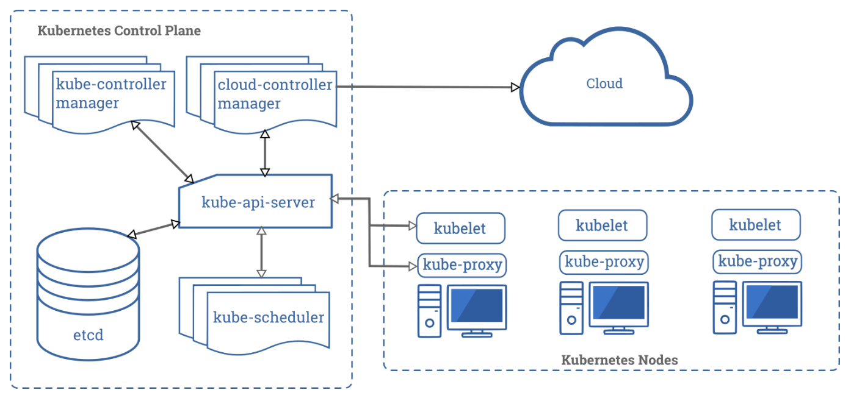
Summary: What does it look like?

Slide 14
AKS vs k8s
Master nodes are managed by Microsoft (this is the same on EKS and GKE)
The kube-system namespace contains infrastructure for sending logs and metrics to azure monitor
Integrates with cloud provider API to provision azure resources to support Kubernetes resources
Load Balancer for public IP addresses
Files and Disks
Logs and Metrics

Slide 15
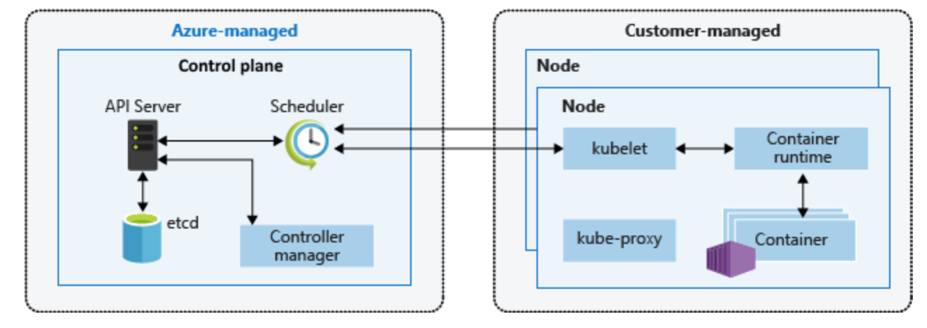
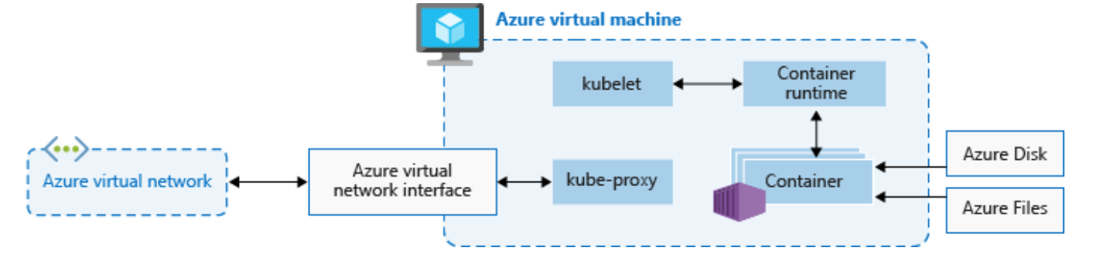
How is a HOSTED k8s Different from default

Slide 16
CRI – Container Runtime Interface
Containers != Docker
OCI (Open Container Initiative) is the spec
Support different container runtimes (docker, runc, rkt, kata containers etc…)
Interface between kubelet and CRI is gRPC/HTTP2
TL;DR Stops and starts containers
Notes:
https://kubernetes.io/blog/2016/12/container-runtime-interface-cri-in-kubernetes/
https://katacontainers.io/

Slide 17
Let’s See it in action

Slide 18
Containers: Like Peas in a Pod
Multiple pods per node
Multiple containers per pod
Share:
Files
Networking
IPC

Slide 19
Pods vs Deployments

Slide 20
What is Ingress?

Slide 21
K8s Extensibility
Kubernetes is built to be an extensible platform.
CustomResourceDefinitions let you define your own resource type.
Deploy code that runs on acts on that resource (operator pattern).
Webhooks for manipulating Kubernetes objects (pods, deployments, etc)
Mutating web hook – Mutate the object before persistence
Validating web hook – Reject the object
Custom scheduler – Decide how pods are scheduled on nodes (hard mode)
Notes:
https://github.com/rynowak/opulence/tree/master/src/Opulence.LogOverrideWebHook
https://github.com/jkotalik/Kestrel-Ingress
https://kubernetes.io/blog/2019/08/06/opa-gatekeeper-policy-and-governance-for-kubernetes/
https://github.com/dapr/dapr/blob/master/pkg/injector/pod_patch.go
https://github.com/docker/compose-on-kubernetes

Slide 22
Summary
What we’ve seen:
Pods
Deployments
Services
ConfigMaps
Ingress
Certmanager
namespace
There’s a whole lot more resource types!
Show diagram of these primitives

Slide 23
Virtual Kubelet
Ability to implement a custom kubelet that schedules pods outside of nodes
Provides a path for running serverless workers on kubernetes
Plugs into existing cloud providers
Notes:
https://virtual-kubelet.io/
https://virtual-kubelet.io/docs/providers/

